Slide 1
Quiz Game
Made by: Haziq, Hassan, Mohib & Arbaz

Slide 2
Game Introduction
In this quiz game there will be options for you to select your choice. To start the game you have to press ‘S' to view the previous highest points press ‘P' and to reset the score press ‘R' and to quit the game press ‘Q'. Now when you will press ‘S' the game will start and it will display the mock test which we also called it as a qualifying round. To pass this round you must answer 3 out of 2 questions correctly. Now after this stage there will be the next stage of selecting the category now & there are 6 categories which will be displayed on your screen.

Slide 3
Quiz Game Categories
Sports quiz
General knowledge quiz
Islamic quiz
Food quiz
General Maths quiz
Programming languages quiz.

Slide 4
Intro continues…
Now if you press ‘S' it will display the sports quiz, by pressing ‘G' it will display the general knowledge quiz, by pressing ‘I' it will display the Islamic quiz, by pressing ‘M' it will display the general maths quiz and by pressing 'P' it will display the programming languages quiz. Each category will display 10 questions. And each correct answer carries 100 points. If your total score is less than 600 it will be displayed that you did not performed well and if your score is greater than 600 and less than 1000 it will display that you performed extremely well . And if your all questions are correct it will display that you have been rewarded with 1000$. Now after finishing the game your score will be saved and you can view it by going into the main menu Or you can play different categories of the the game by pressing ‘Y‘.

Slide 5
Game Purpose
Managing a time is very important in our life. It is very important to use our time in the right place. We waste most of our time in social media and any other source of internet and instead of benefiting us, it only harms us. It is better to spend our time in something that benefits us and increases our knowledge and sharpen our mind.

Slide 6
Features
There will be two stages in this Quiz Game. In the first stage of game, three question will be asked from the user and two answers out of three questions must be given correctly for the player if he or she wants to play the second stage otherwise the player will not be eligible for second stage.
User can play this game at any time and it can play again and again if the user wants.
If the players answers the questions correctly he/she will be awarded with 100 points for each correct answer.
If any user succeeds in achieving all the correct answers he/she will be awarded with $1000.
In the end, there is also a Message with score about your performance
User can view his/her last highest points at any time.

Slide 7
Language and Software Tools
Programming Language | C
Operating System | Windows 10
C Compiler | TCC

Slide 8
Distribution Of Work
Haziq & Hassan
Mohib & Arbaz
All the categories which will be displayed are done together by Haziq & Hassan.
All the functions and other type of content like mock test, reset score, start and end game etc are done together By Mohib and Arbaz .

Slide 9
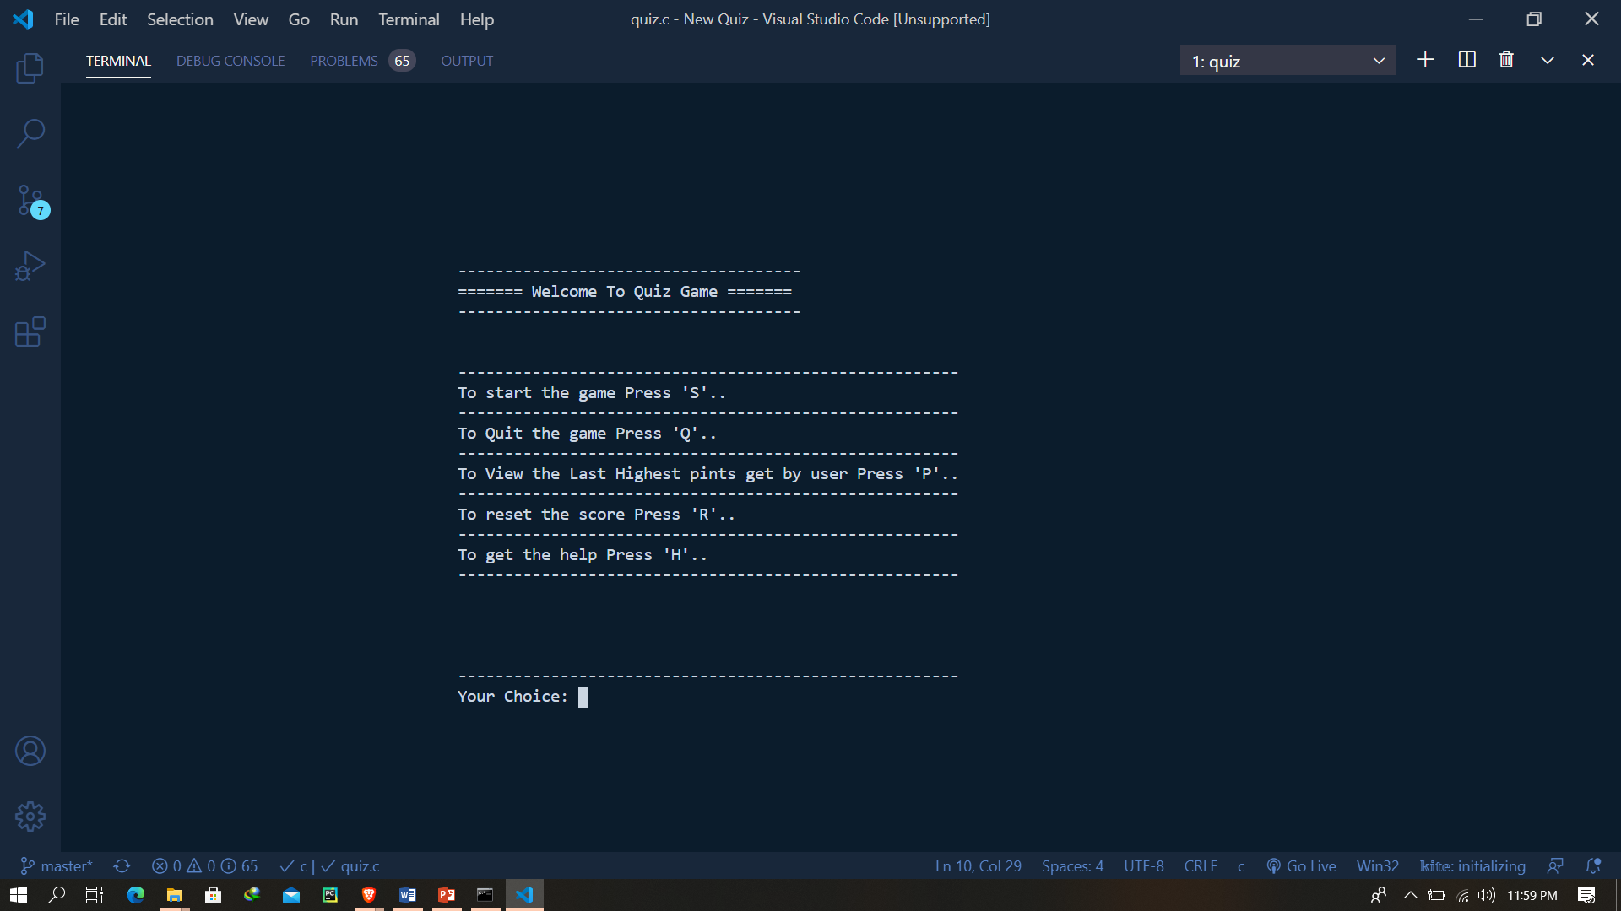
Main Home Screen

Slide 10
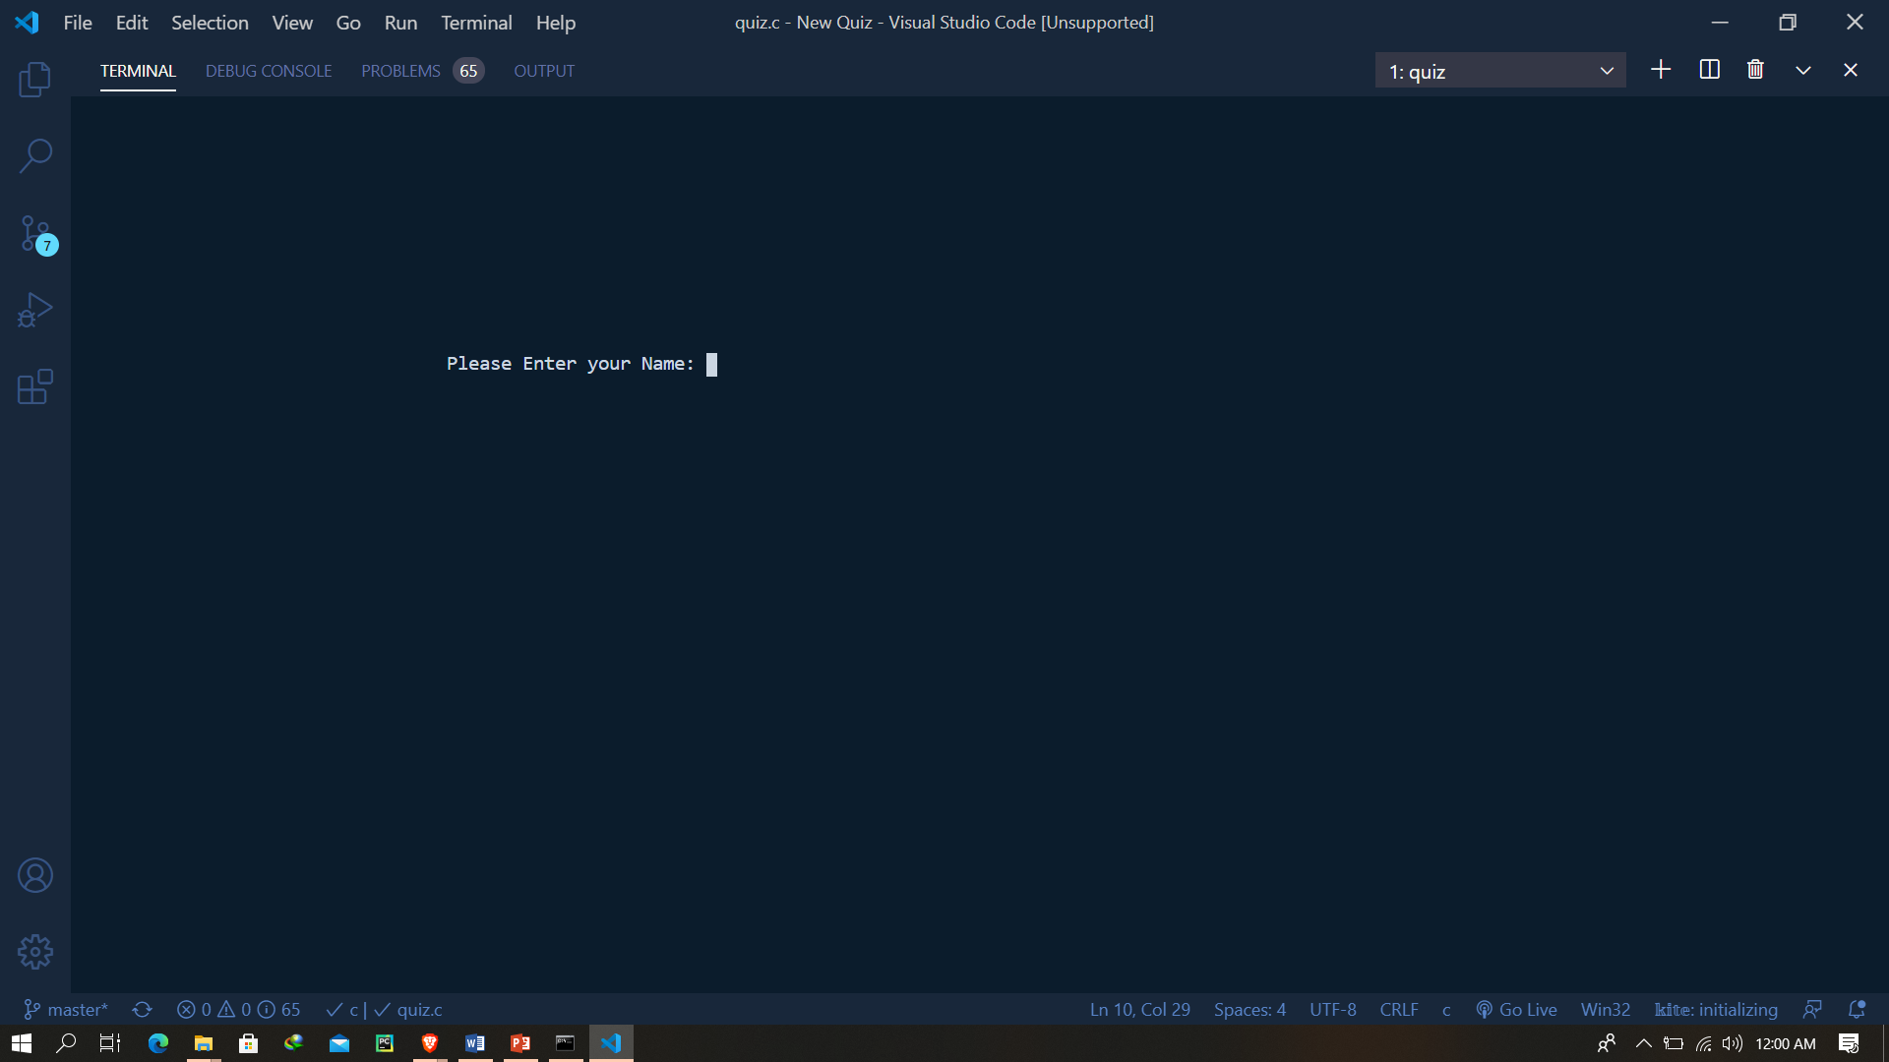
Enter User Name screen

Slide 11
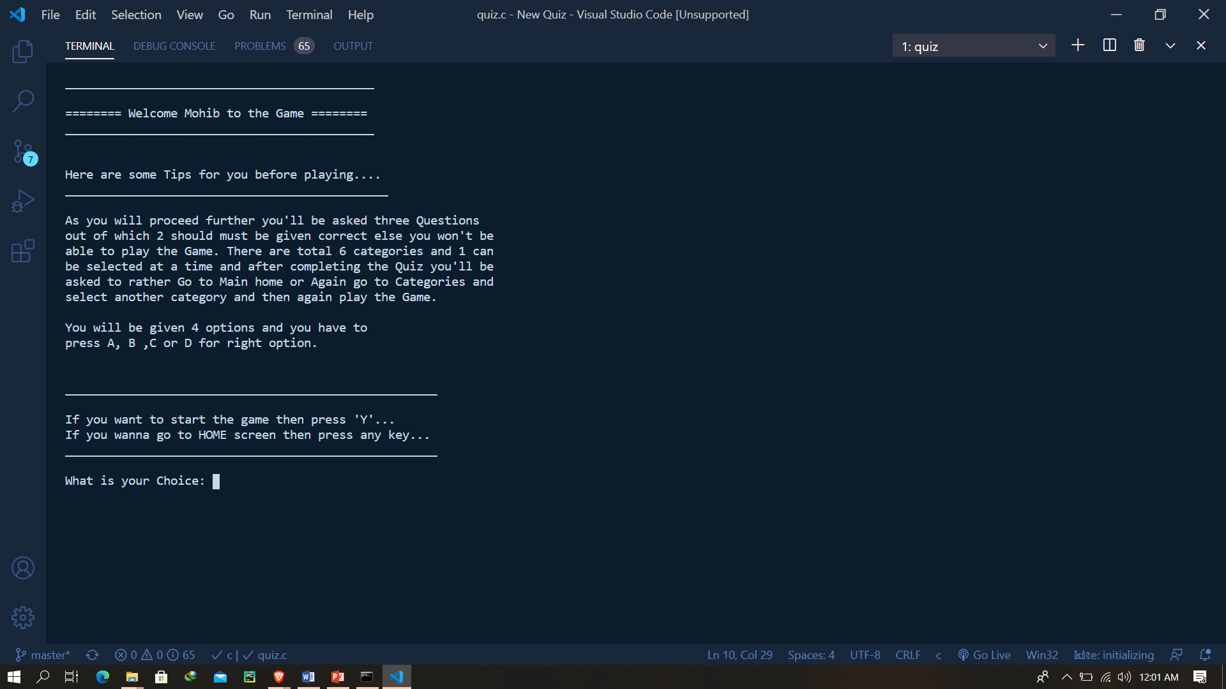
Game Starting screen

Slide 12
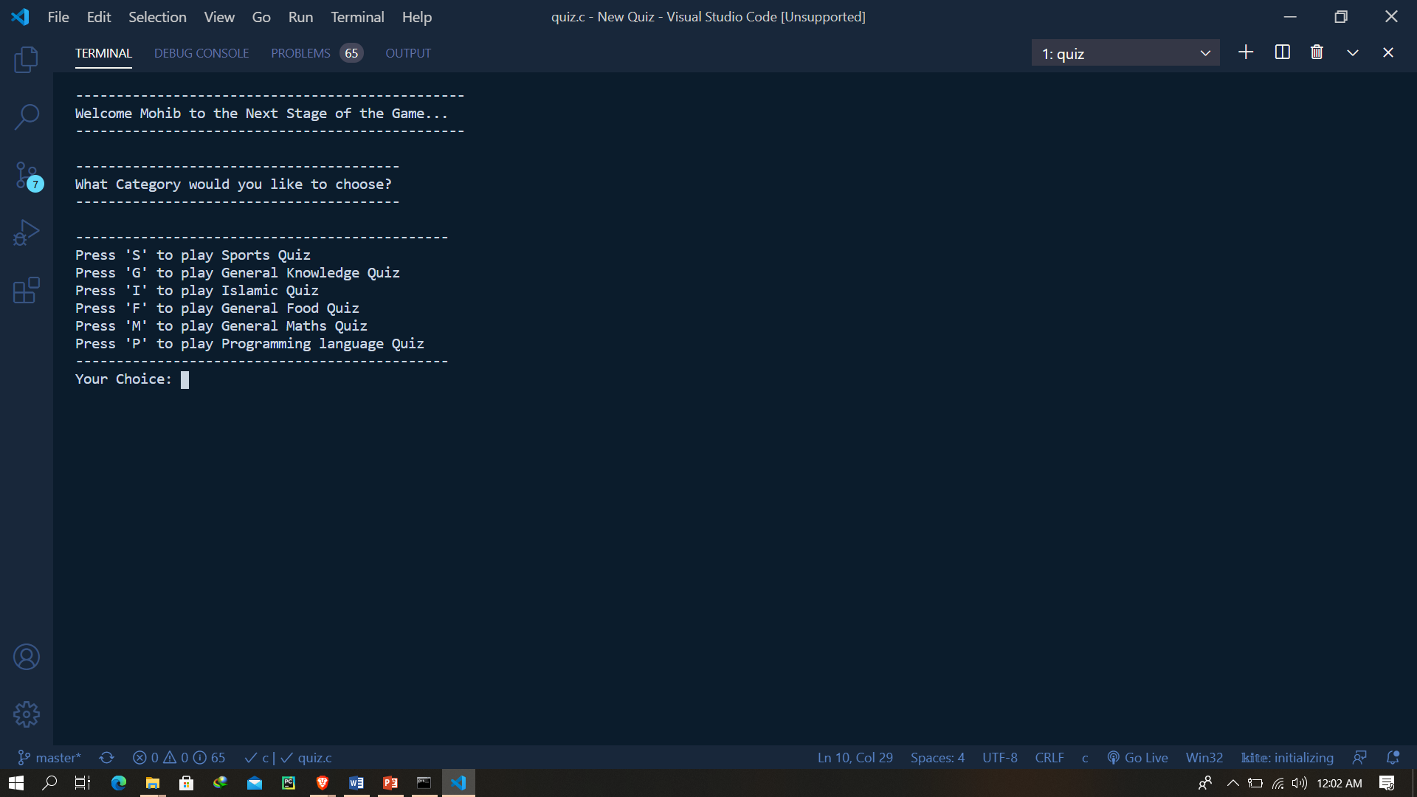
After Clearing the Qualifying Round

Slide 13
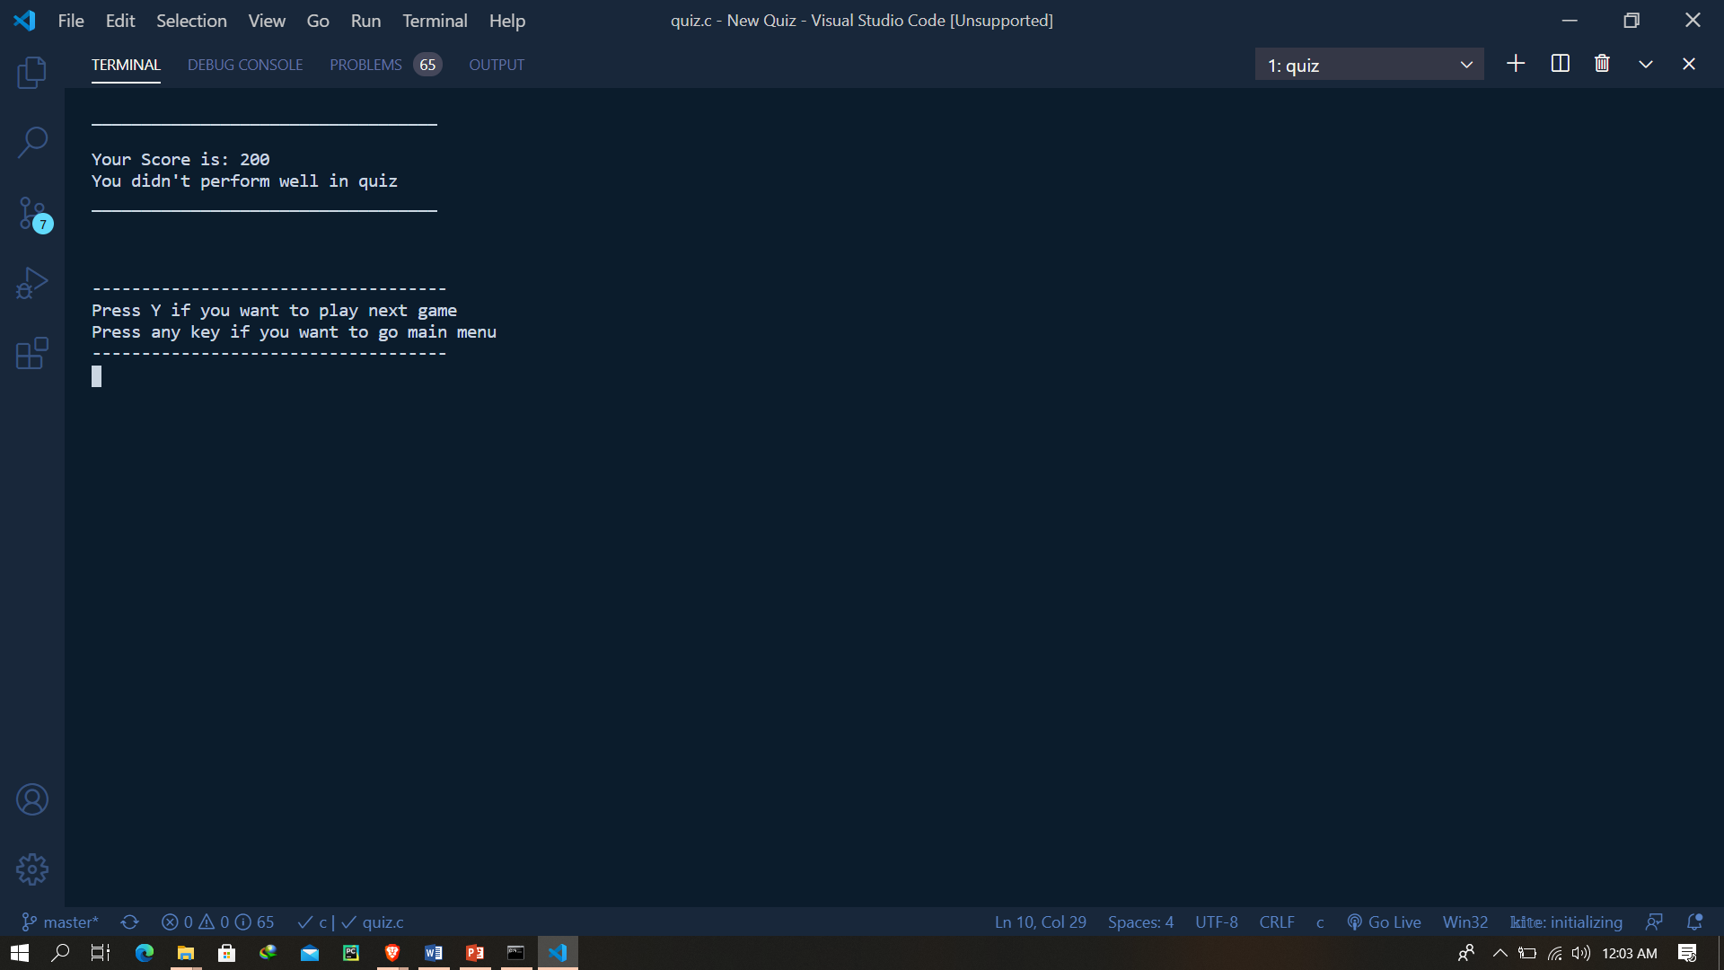
Quiz Score & Remarks Screen

Slide 14
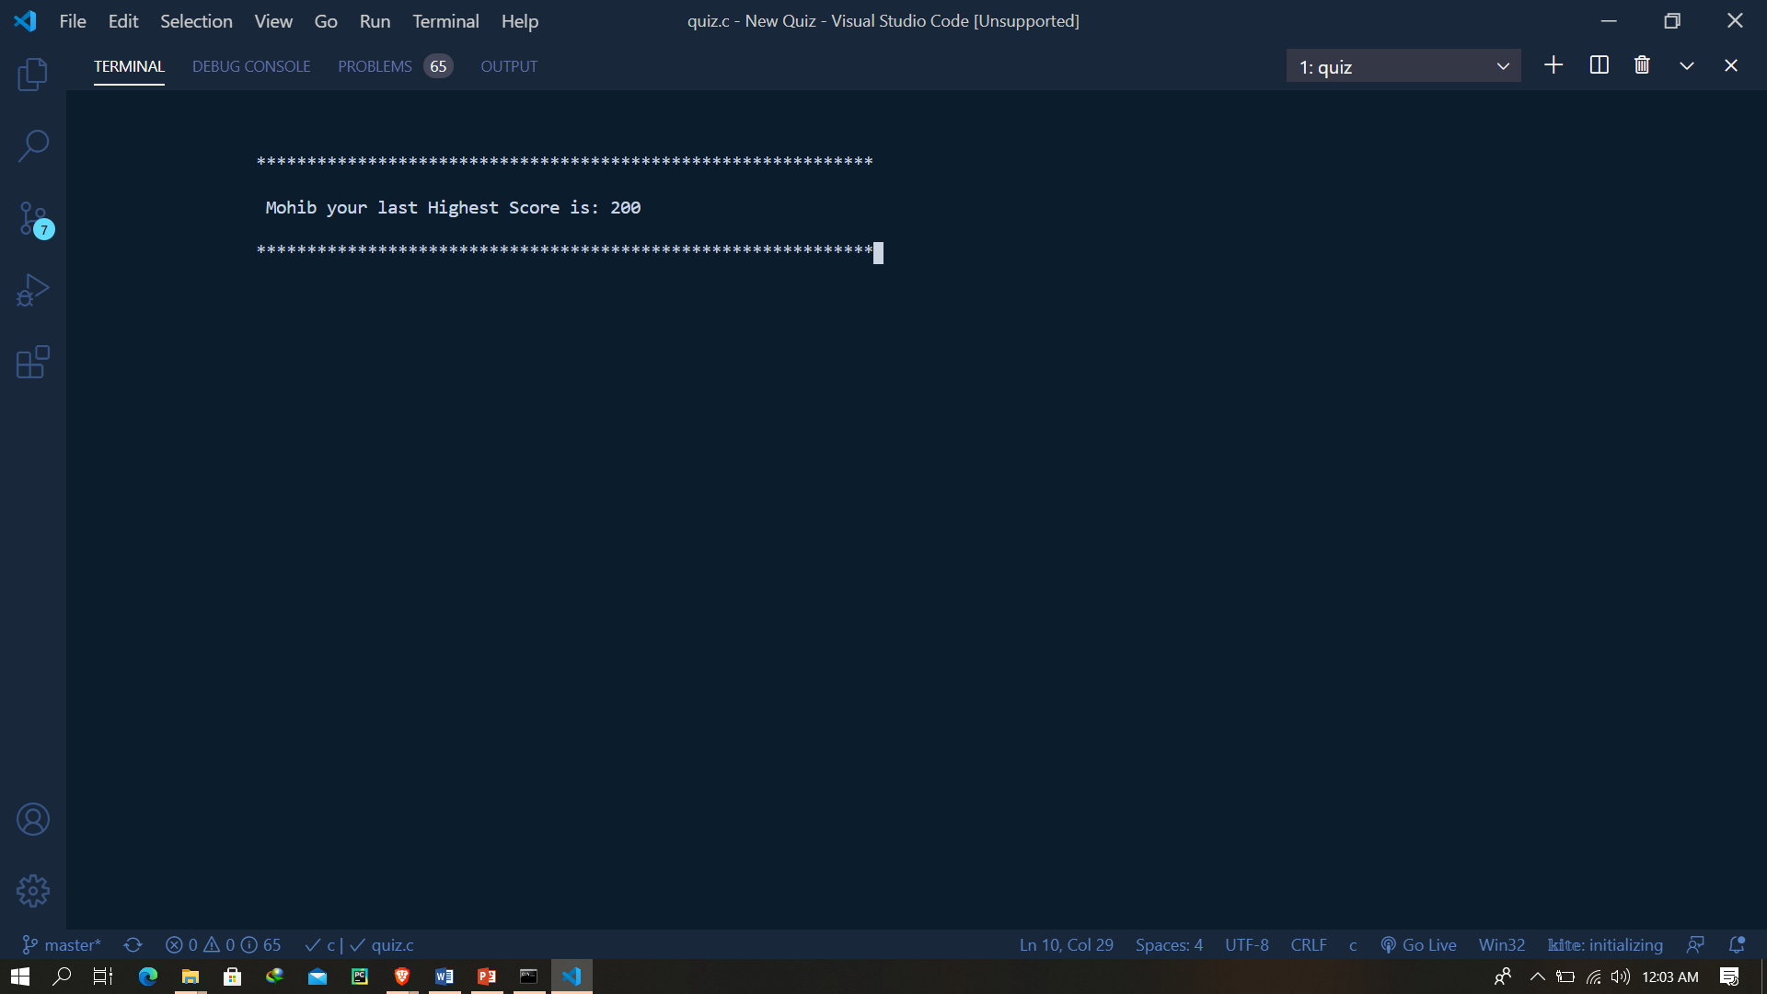
Last Highest points Screen

Slide 15
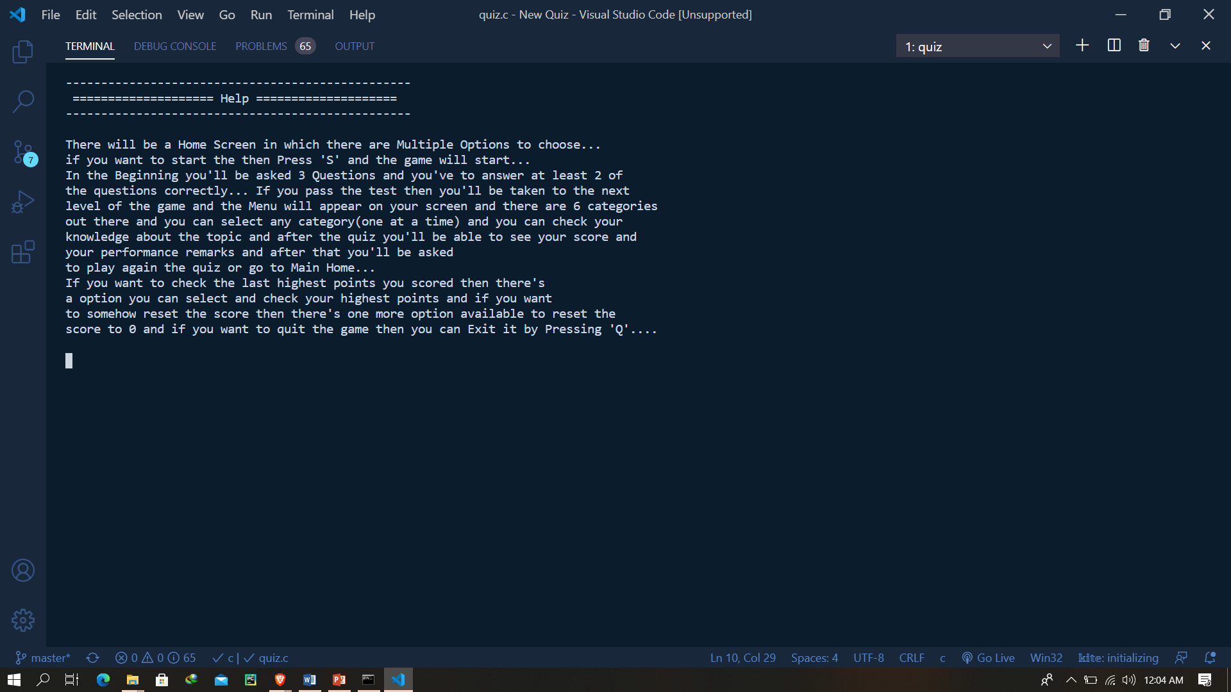
Help Screen

Slide 16
The End
Thankyou!!

